Slide 1
Prioritize
CODY, JOEL, SHAHRUKH, WAJAHAT

Slide 2
System/Algorithm Analysis
Implemented Algorithms:
Priority Algorithm
Converting JSON to the SQLite database
Database Lookup

Slide 3
Brief Reminder Description
Event Description
Priority Value
Due Date(s) and Time (time is optional)
Repeat Every ‘x’ Days
Alarm or Alert
Calculated Alert Date and Time

Slide 4
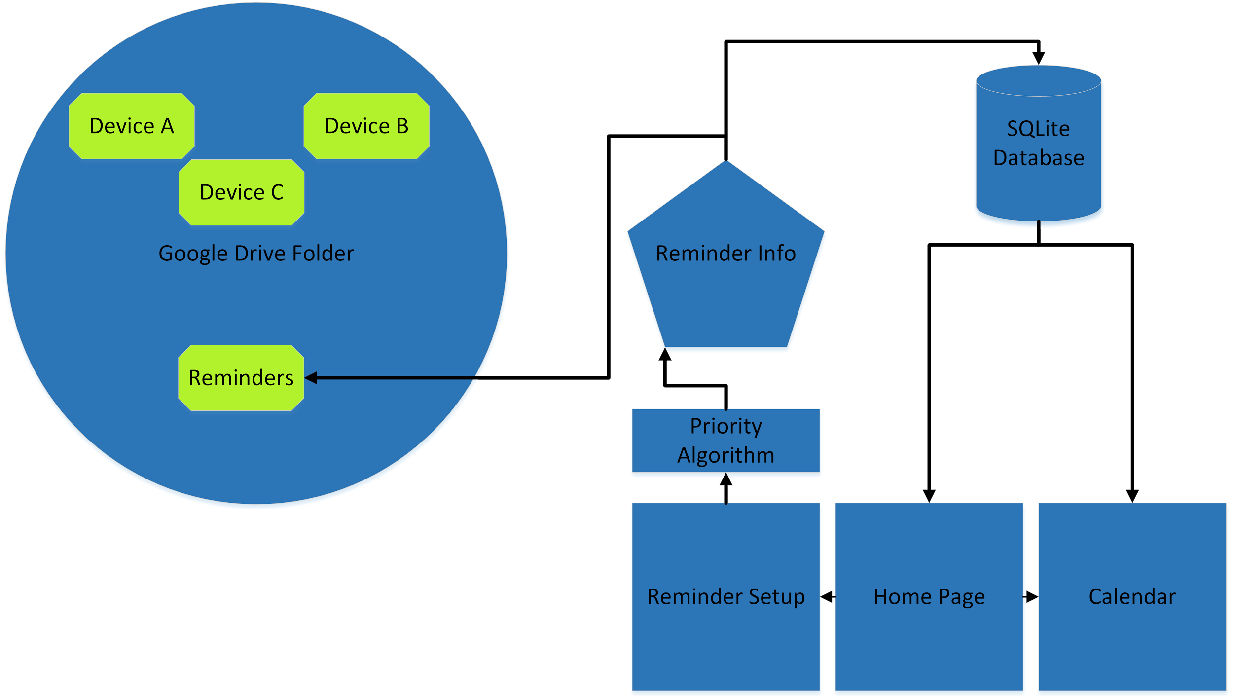
Data Flow: Adding a Reminder

Slide 5
Priority Algorithm
Step 1: Get the number of days between the current date and the
deadline of the reminder. Operates on 3 while loops.
O(d+m+y), where d=days, m=months, y=years.
But ends up at:
O(y) or O(n)
Step 2: Find how many days until the app alerts the user.
Step 3: Find where that number of days falls on the calendar, also ends
up at:
O(d) or O(n)

Slide 6
Database Lookup
Some information is immediately needed on app launch.
An index will be put on the reminder description, date of set reminder, date of deadline, priority, and a unique key, for a time complexity of O(log(n))

Slide 7
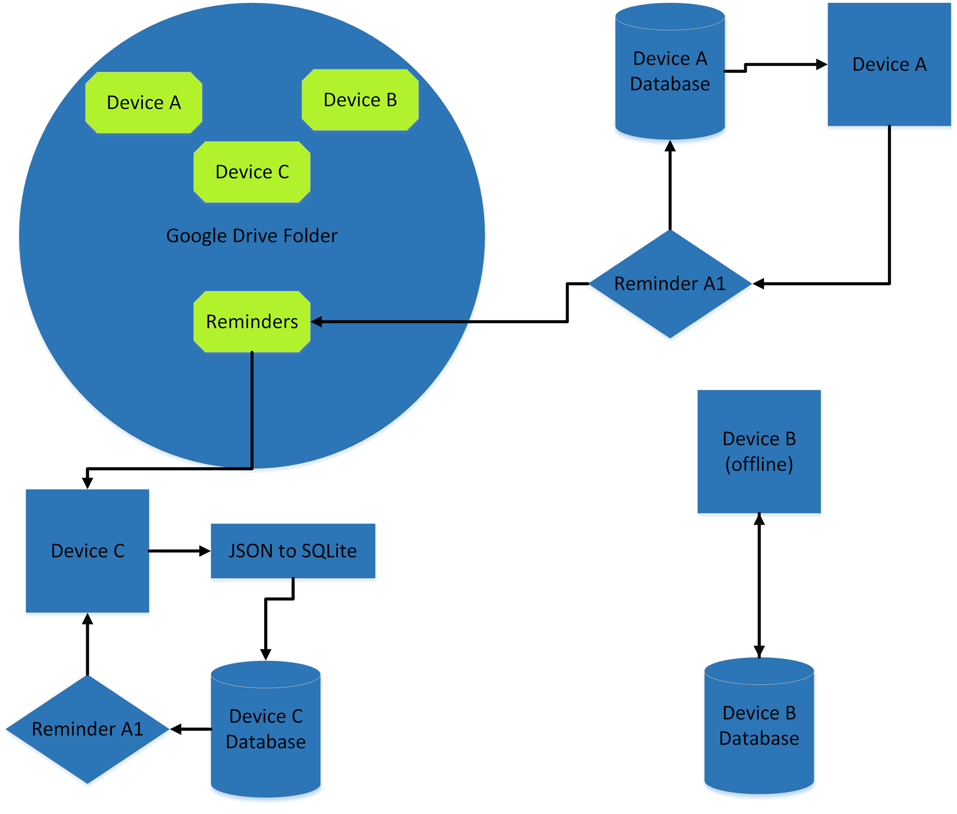
Data Flow: Syncing Reminders Across Android Devices

Slide 8
JSON to SQLite Database
Parsers tend to be O(n) where n = number of lines.
Each JSON entry will only vary in the number of dates the
reminder is assigned to have by the user. O(n+d)

Slide 9
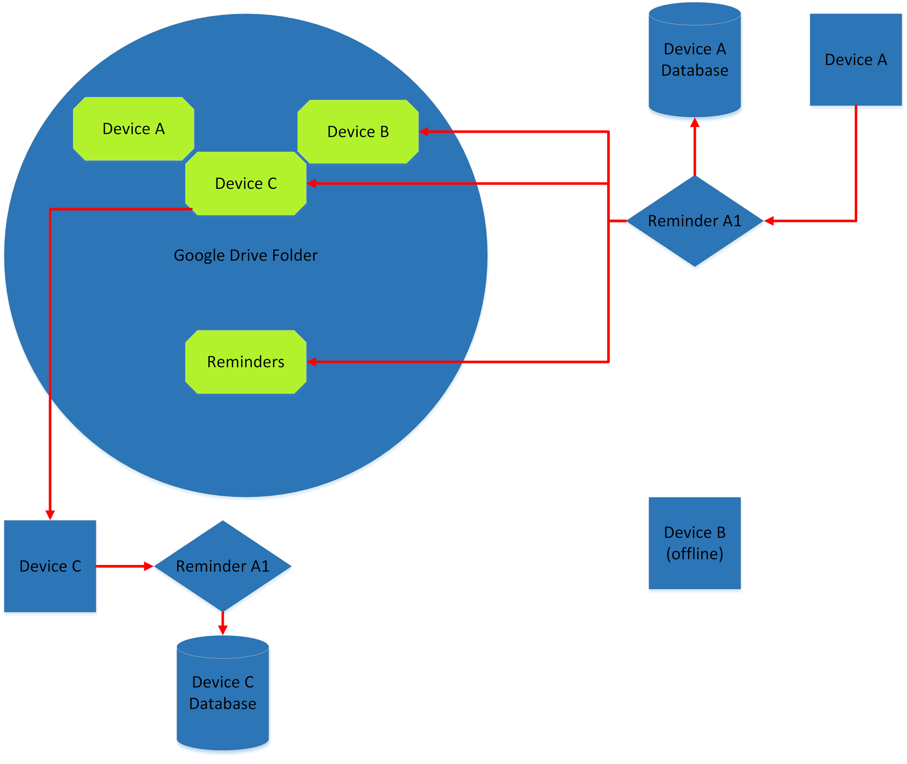
Data Flow: Deleting a Reminder

